Slide 1
KABGAYI DISTRICT HOSPITAL
ISANGE ONE STOP CENTER
BY UWIZEYIMANA JUDITH
GBV OFFICER at KABGAYI D H

Slide 2
OVERVIEW OF IOSC
IOSC was initiated by the government of Rwanda in 2009 but at Kabgayi hospital it started in June 2014 with financial support from the Royal Netherlands Embassy through UN Women
It serves a total population of 340.464 from Muhanga district and other population from Ruhango,Kamonyi,and Ngororero Districts.
IOSC Kabgayi is composed of 8 rooms
All staff have been trained in management of SGBV cases in a multidisciplinary way/Interventions

Slide 3
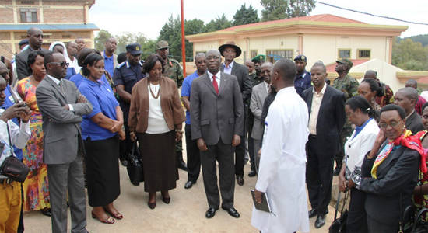
Launched by Hon . Former prime minister 16th,October 2015

Slide 4
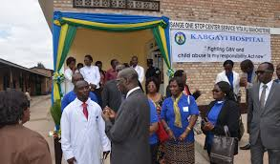
Launched by Hon Prime Minister in October 2015

Slide 5
SERVICES DELIVERED
Free of charges Services:
Medical
Psycho-Social support
Legal
Social reintegration

